Slide 1
Investigation of Image Classification based on Transfer Learning and Siamese Network
Ke Fan, Abdullateef Almudaifer, Sungman Kang

Slide 2
Agenda
Objective
Dataset Processing
Transfer Learning
Implementation 1
Siamese Network
Implementation 2
Evaluation

Slide 3
Objective
Compare a simple Siamese network features with transfer learning approach on shoes dataset classification accuracy.
Investigate the effect of Siamese network on the features from transfer learning.

Slide 4
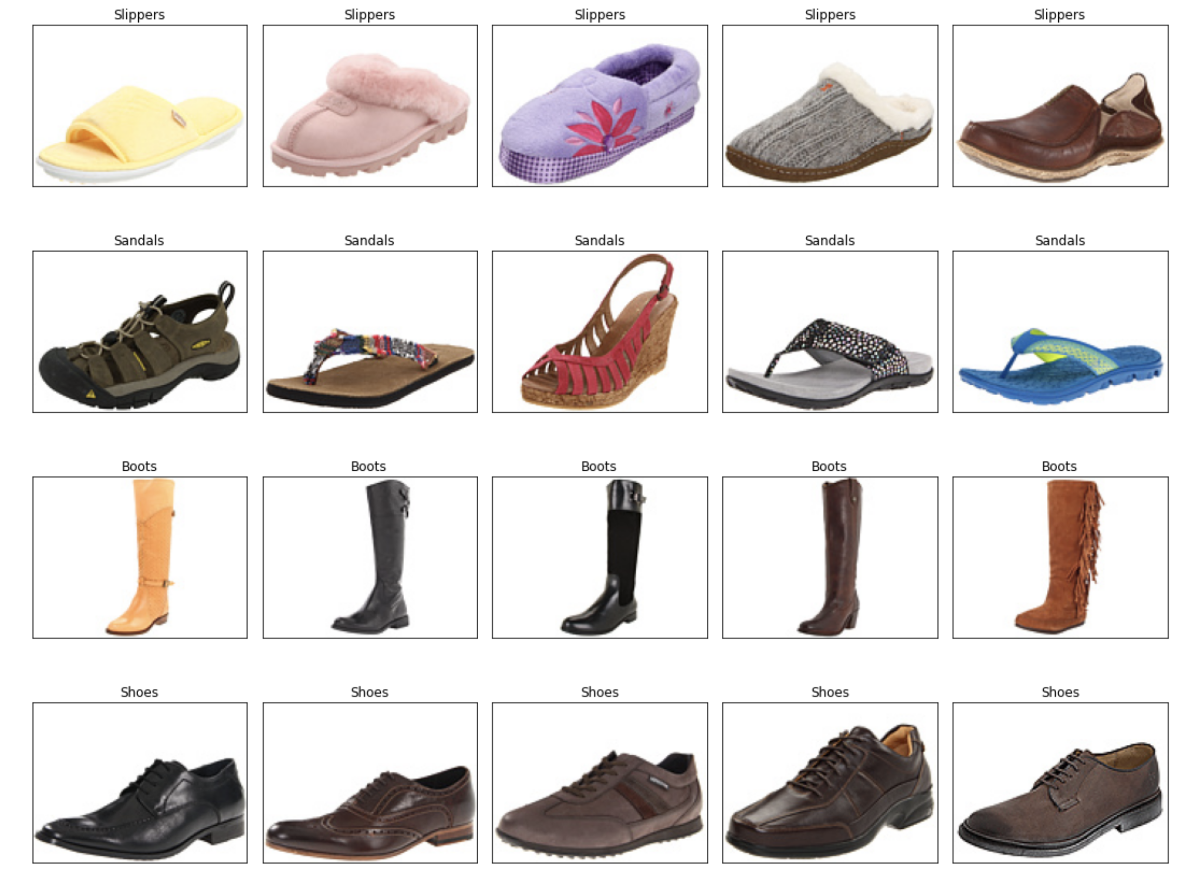
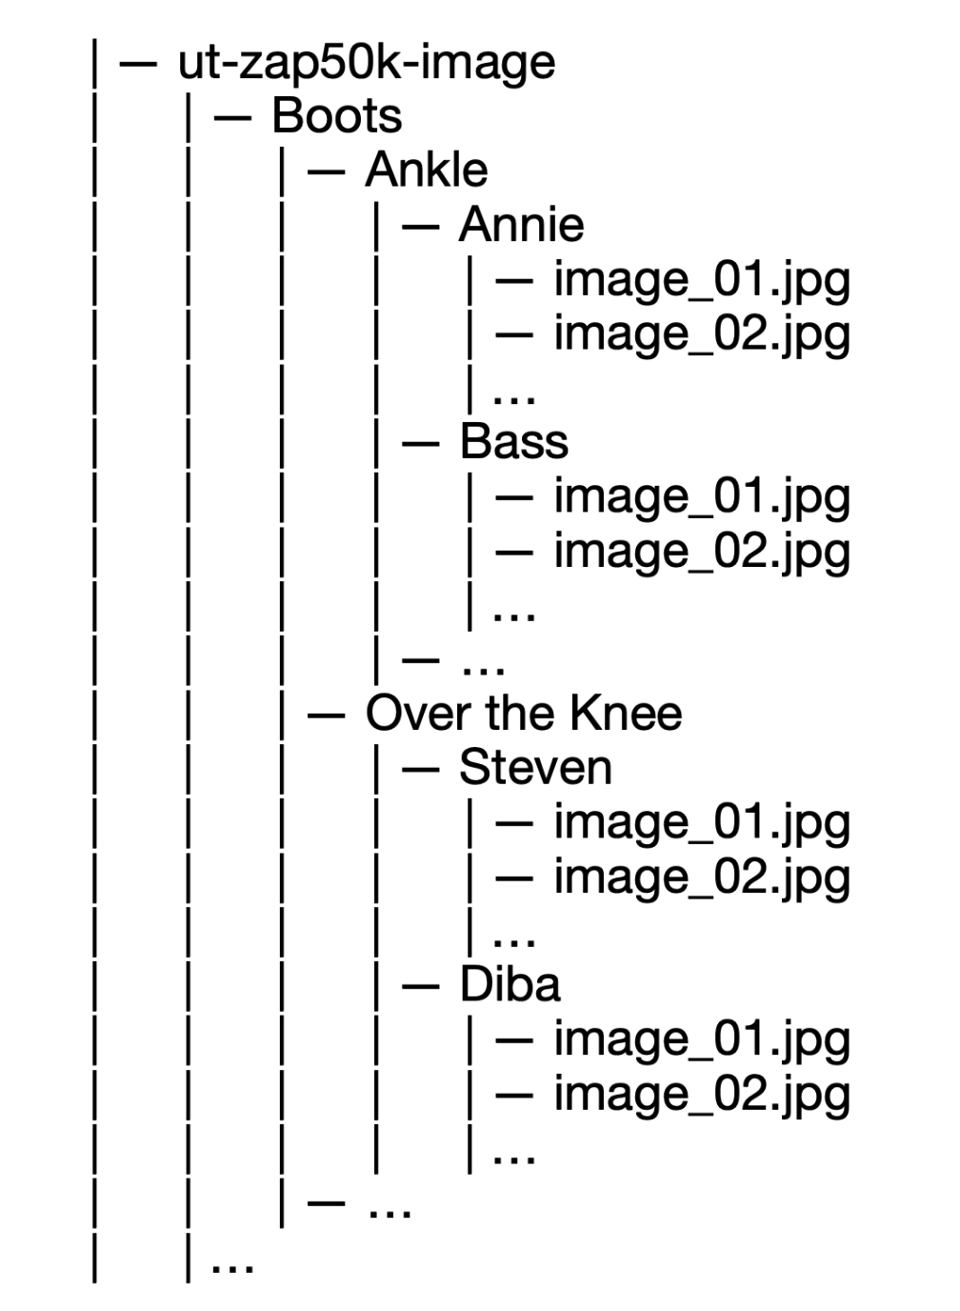
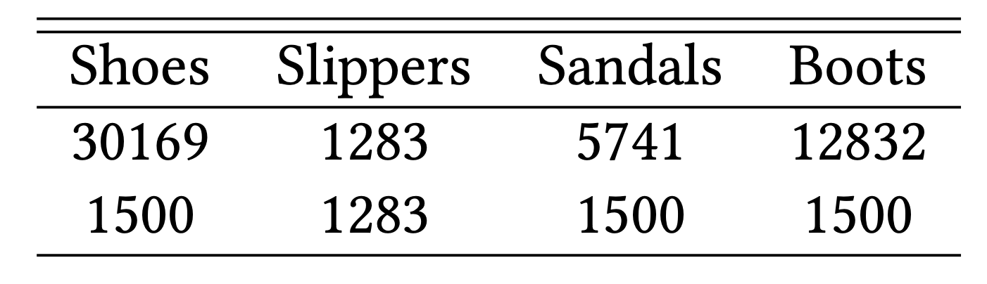
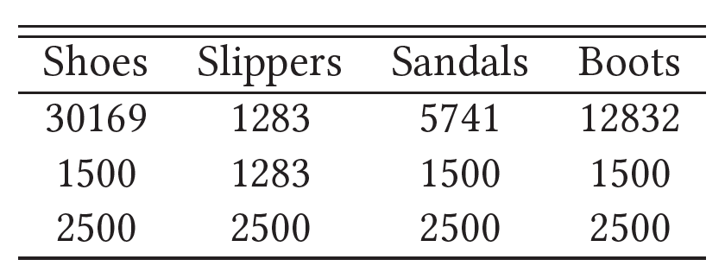
Dataset
Fig.1: Examples from the dataset.
http://vision.cs.utexas.edu/projects/finegrained/utzap50k/

Slide 5
Transfer Learning

Slide 6
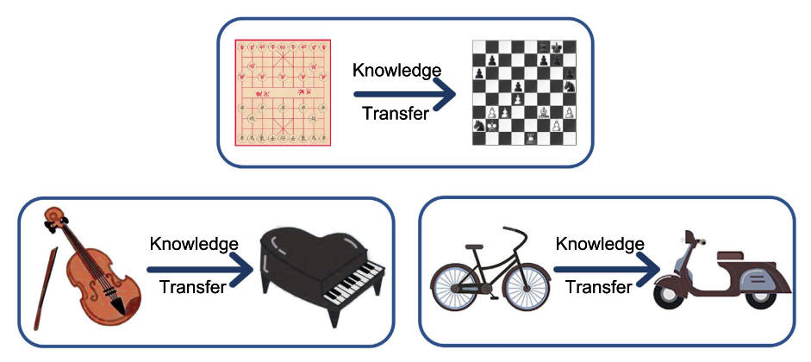
Transfer Learning
Fig. 2: Intuitive examples about transfer learning.
Source: A Comprehensive Survey on Transfer Learning https://arxiv.org/pdf/1911.02685.pdf

Slide 7
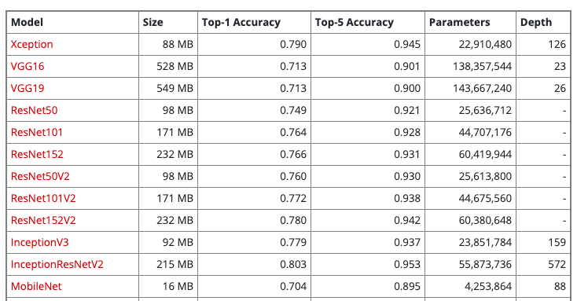
Xception
Table 1: part of available models on Keras applications
https://keras.io/api/applications/

Slide 8
Xception
Fig. 3: Xception architecture
Xception: Deep Learning with Depthwise Separable Convolutions https://arxiv.org/pdf/1610.02357.pdf

Slide 9
Implementation
scores
Probabilities
shoes
shoes
G.A.B
sandals
softmax
sandals
Xception
slippers
slippers
3, 3, 2048
2048
boots
boots
scores
Probabilities
shoes
shoes
FC
+
Relu
G.A.B
sandals
sandals
Xception
softmax
slippers
slippers
2048, 3, 3
2048
boots
boots
512
Figure 4: implemented transfer learning architectures. G.A.B: GlobalAveragePooling

Slide 10
Siamese Network

Slide 11
Siamese Network
Img
CNN
Shared weights
Loss
…
…
…
Shared weights
Img
CNN
Input image
Sub-networks
Embeddings

Slide 12
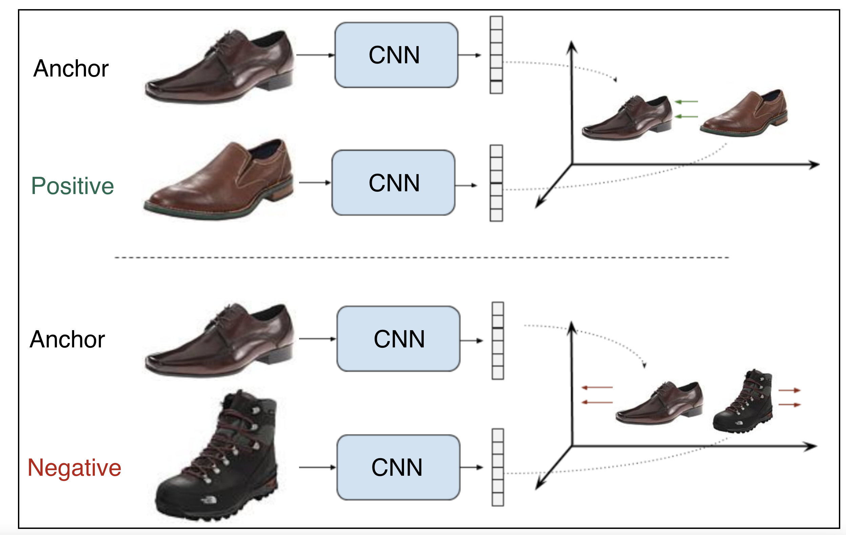
Contrastive Loss
Shared weights
pull
[1]
push
Shared weights
[0]
Figure X: Example of a contrastive ranking loss training setup
SCHOOL OF - to apply in all slides at the same time edit in Insert > Header & Footer

Slide 13
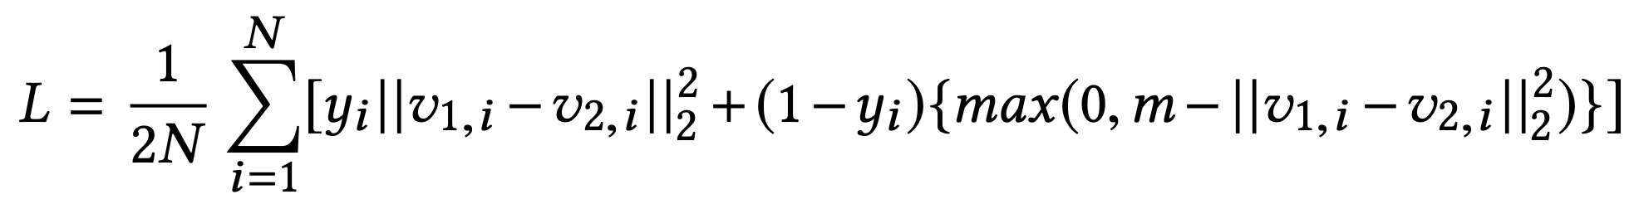
Contrastive Loss Function
$$v_{1,i},v_{2,i}$$
: embedding vectors of the two samples in a pair
$$y_{i}$$
: binary label (1 for a positive pair and 0 for a negative pair)
m: margin, N: the number of batches
SCHOOL OF - to apply in all slides at the same time edit in Insert > Header & Footer

Slide 14
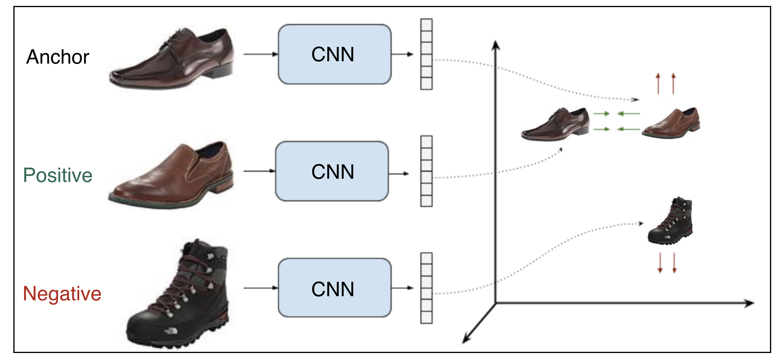
Triplet Loss
Shared weights
pull
push
Shared weights
Figure X: Example of a contrastive ranking loss training setup
SCHOOL OF - to apply in all slides at the same time edit in Insert > Header & Footer

Slide 15
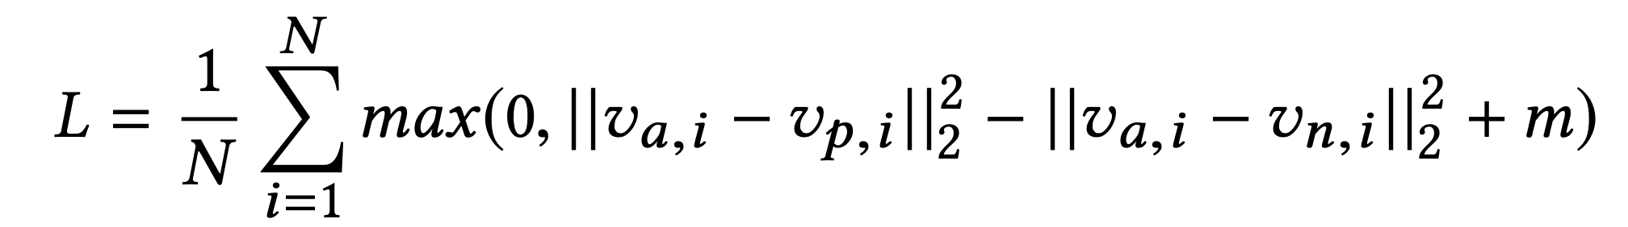
Triplet Loss Function
$$v_{a,i},v_{p,i},v_{n,i}$$
: embedding vectors of the anchor, positive, negative in a triplet
m: margin, N: the number of batches
Easy Triplets:
$$d(v_{a,i},v_{n,i})>d(v_{a,i},v_{p,i})+m$$
Hard Triplets:
$$d(v_{a,i},v_{n,i})<d(v_{a,i},v_{p,i})$$
Semi-Hard Triplets:
$$d(v_{a,i},v_{p,i})<d(v_{a,i},v_{n,i})<d(v_{a,i},v_{p,i})+m$$
SCHOOL OF - to apply in all slides at the same time edit in Insert > Header & Footer

Slide 16
Implementation

Slide 17
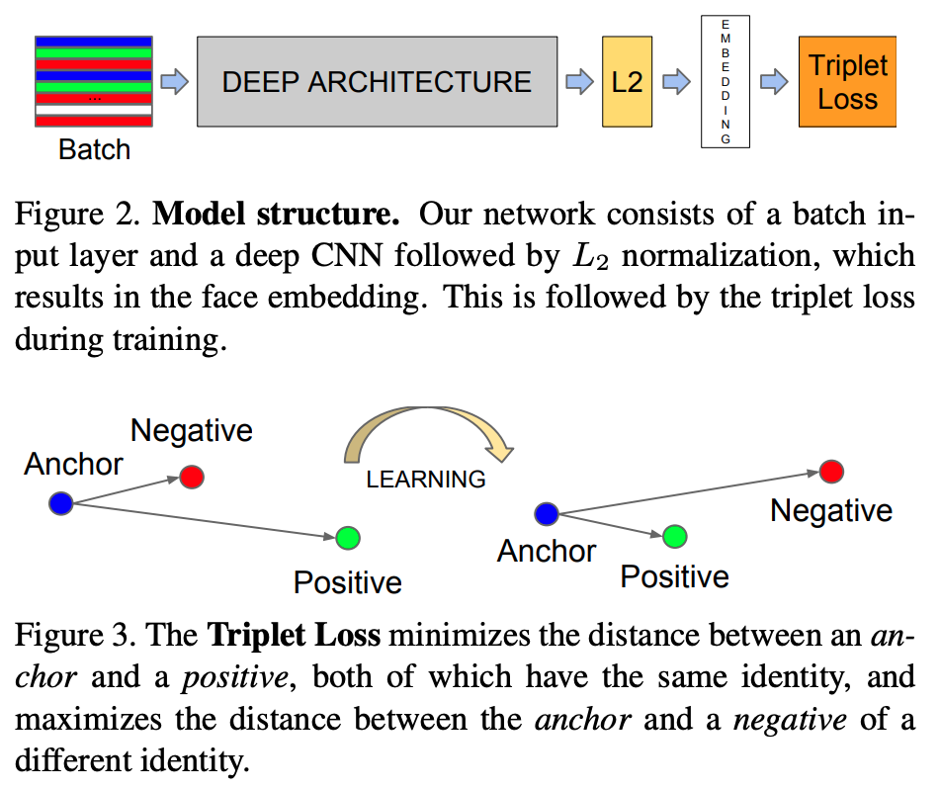
Architecture
32
512
Loss
FC
Classes
SCHOOL OF - to apply in all slides at the same time edit in Insert > Header & Footer

Slide 18
Implementation
Offline pair mining
defined before training
Online triplet mining
defined for every batch during training

Slide 19
Pairs
Label [1]
Label [0]

Slide 20
Triplets

Slide 21

CNN Architecture
(102x102x3)
(64, 2 x 2 filters)
102x102x64
(2 x 2 stride)
(64, 2 x 2 filters)
40,000
2048
512
4
51x51x64
51x51x64
1
2
3
(2 x 2 stride)
25x25x64
4

Slide 22
Xception + Siamese Network
(102x102x3)
1024
512
(2048,3x3)
(2048)
1
2
3
Xception
G.A.B
4
XCEPTION
G.A.B

Slide 23
Evaluation

Slide 24
Evaluation – old run
model | Accuracy % | Epochs | Time (mins)
Xception (T0) | 91.8 | 20 | 1.8
Xception + dense (T1) | 90.7 | 20 | 3.5
Xception All (T2) | 95.1 | 10 | 5.4
Our Siamese + Con. Loss (S0) | 92.75 | 32 | 6
Our Siamese + Triplet. Loss (S1) | 91.02 | 20 | 2
Xception + Siamese (S2) | 95.85 | 10 | 2
model | Accuracy % | Epochs | Time (mins)
Xception (T0) | 89.9 | 20 | 4
Xception + dense (T1) | 89.3 | 20 | 4
Xception All (T2) | 94.0 | 10 | 6
Our Siamese + Con. Loss (S0) | 90.20 | 32 | 14
Our Siamese + Triplet. Loss (S1) | - | - | -
Xception + Siamese (S2) | - | - | -
Table1: Results on 1500 images
Table2: Results on 2500 images

Slide 25
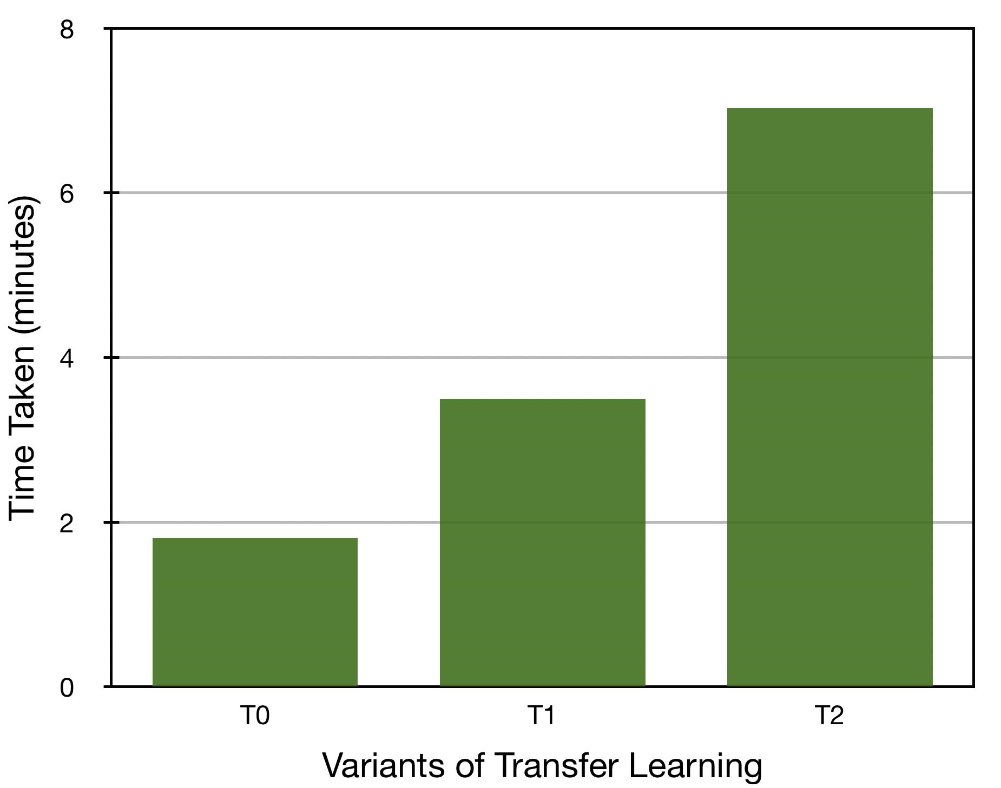
Comparison of Transfer Learning
Figure X: Description

Slide 26
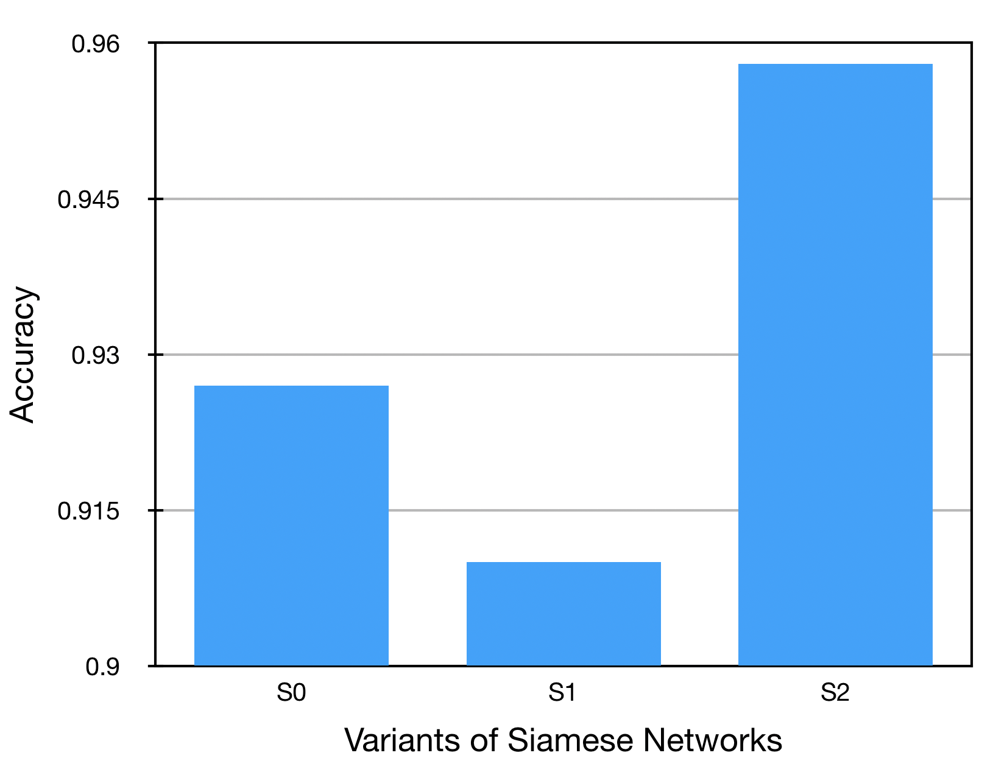
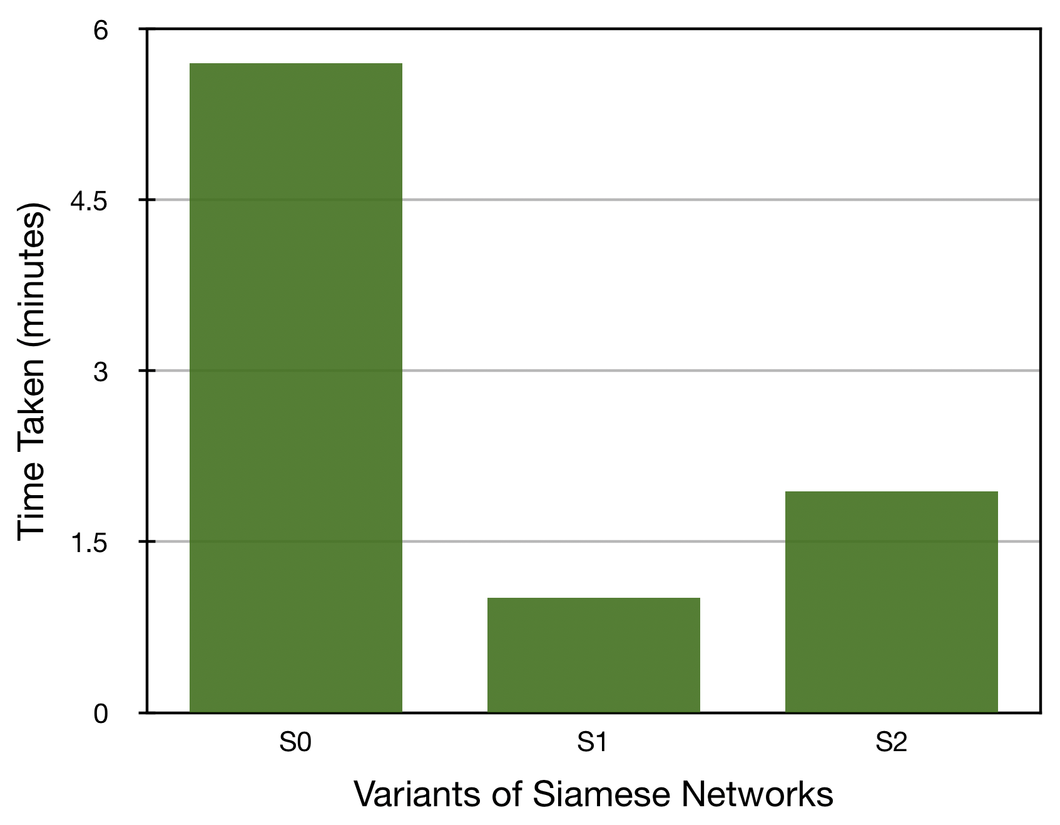
Comparison of Siamese Network
Figure X: Description

Slide 27
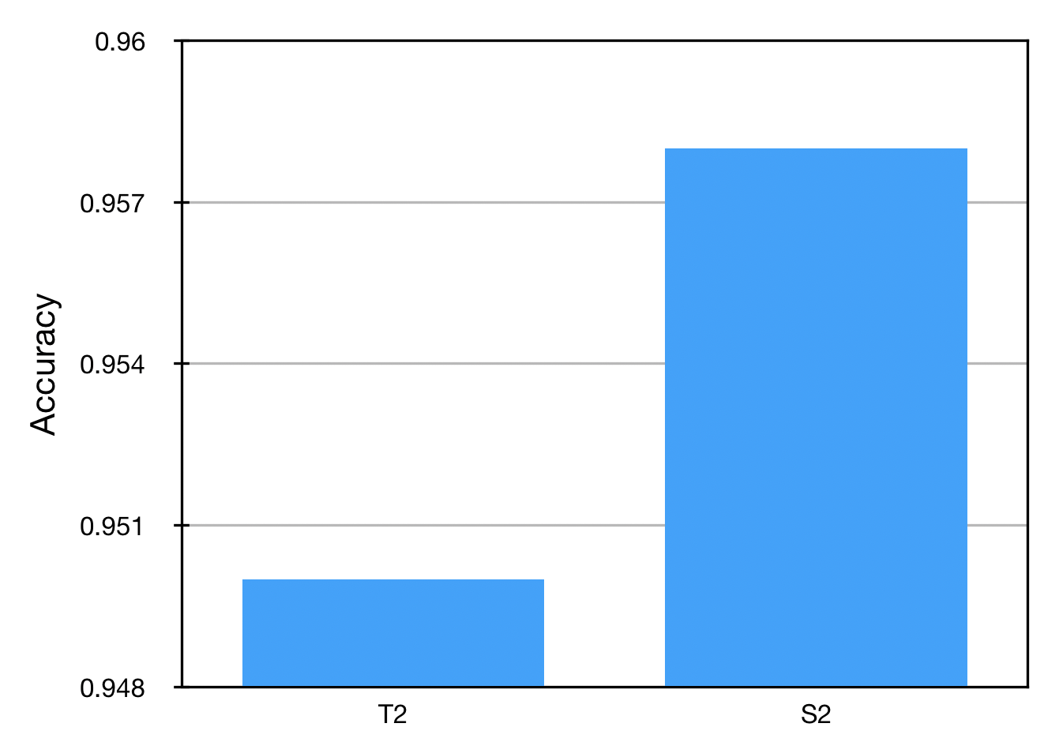
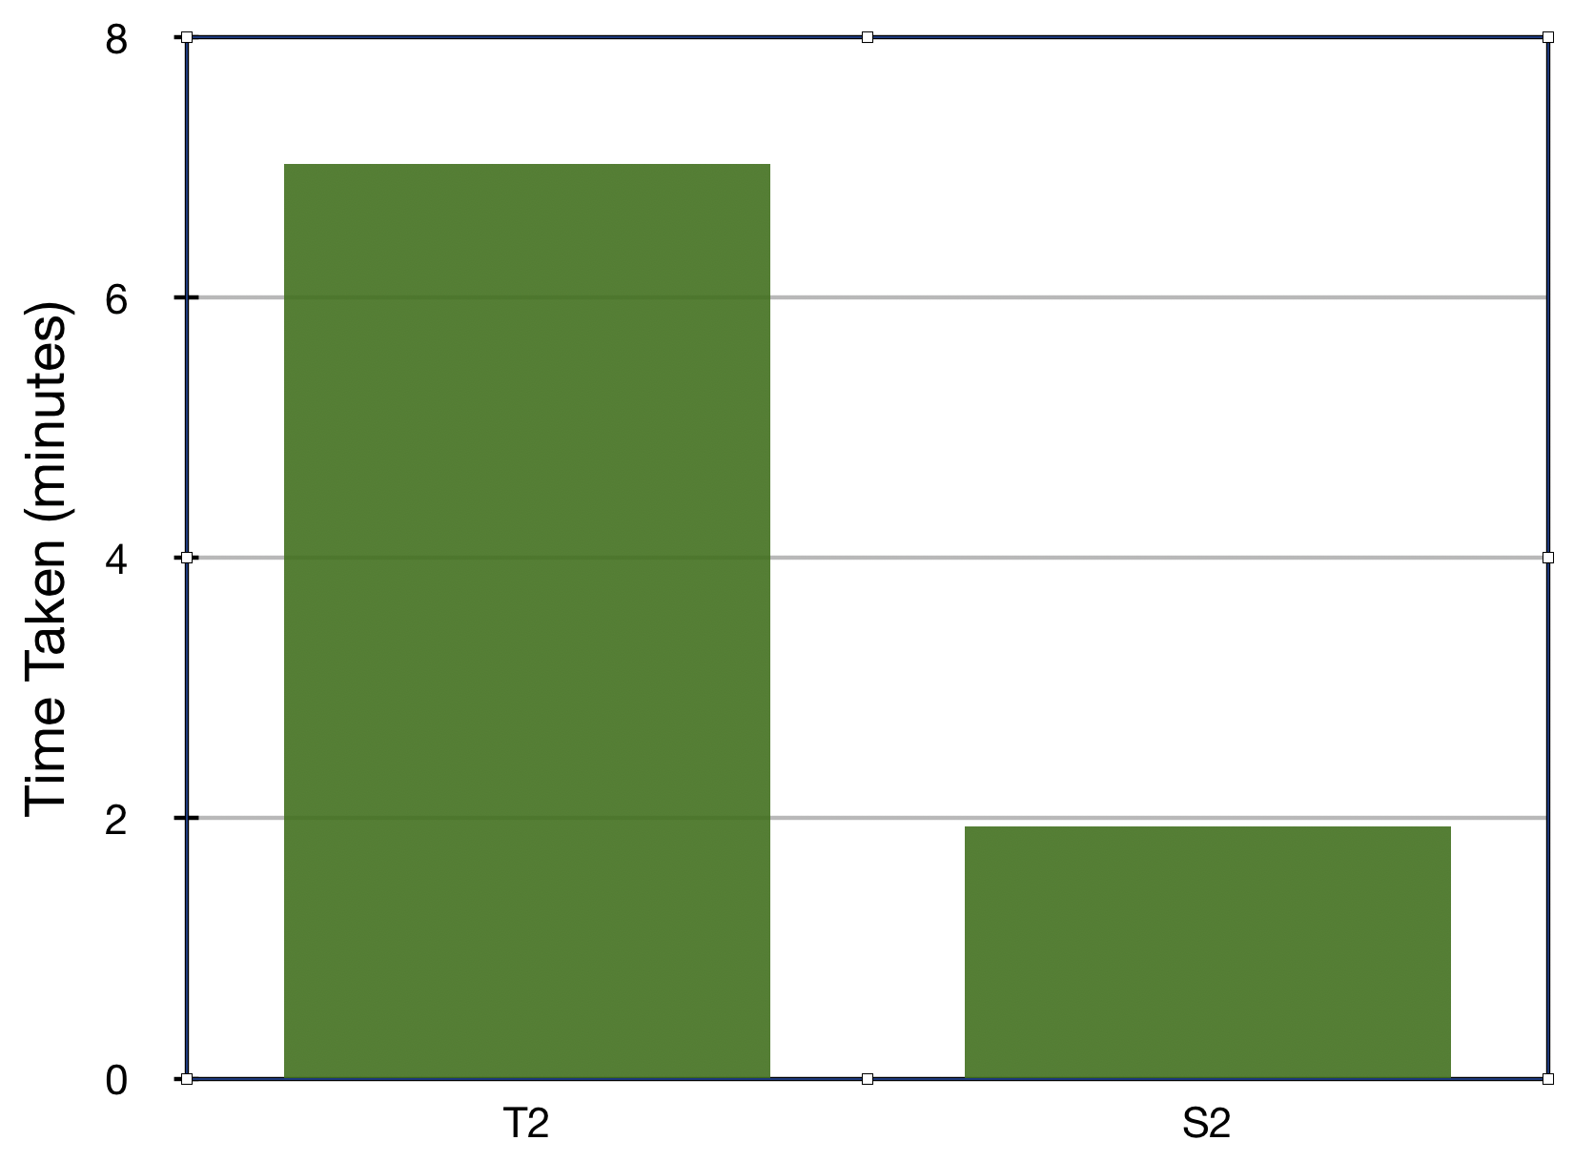
Comparison best models
Figure X: Description

Slide 28
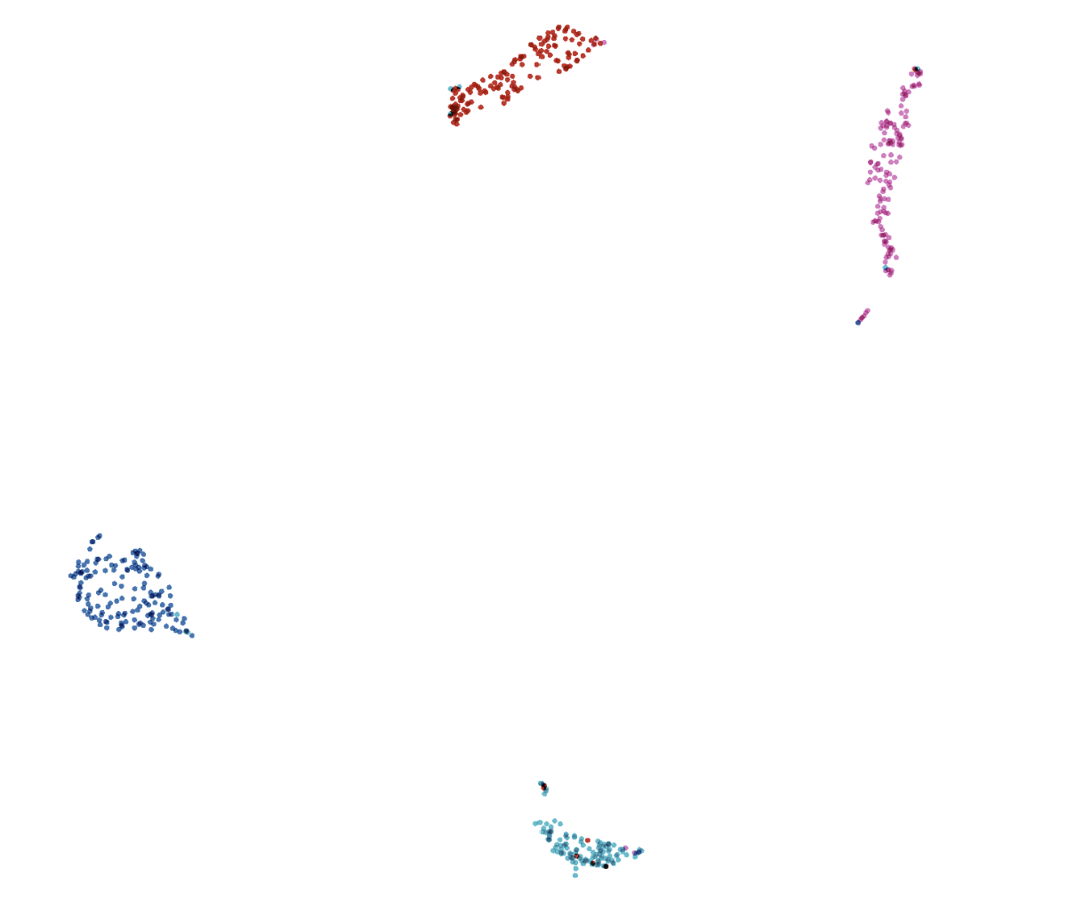
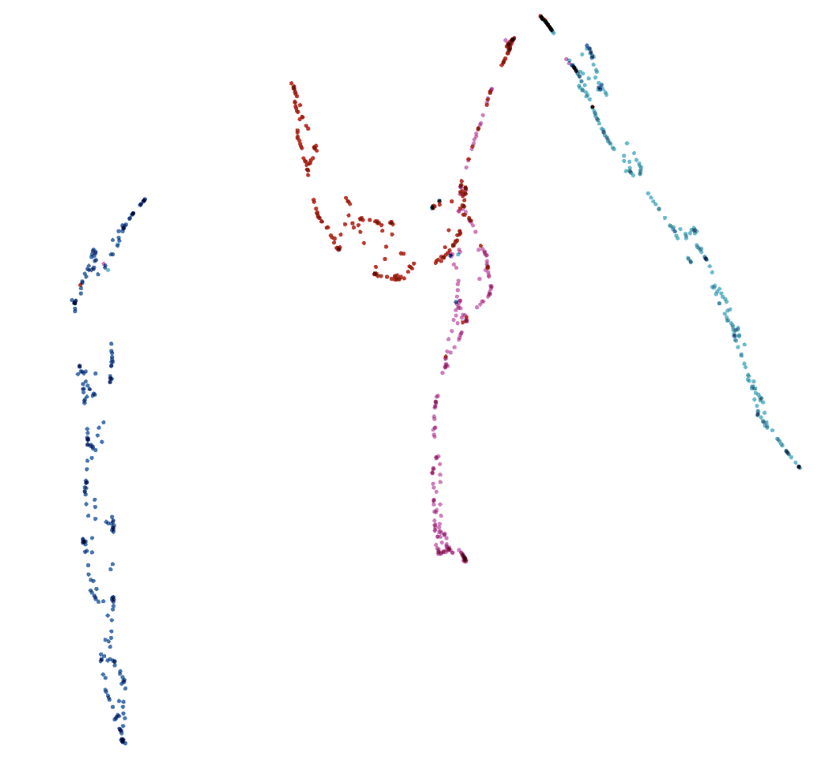
Comparison best models
(a) Xception + Siamese
(b) Xception all
Figure X: visualization of embedded test data projected to 2D space with UMAP using https://projector.tensorflow.org/

Slide 29
Thank you!

Slide 30
Triplet Loss
https://www.tensorflow.org/addons/tutorials/losses_triplet

Slide 31
Triplet Mining
Easy Triplets:
Hard Triplets:
d(, ) < d(, )
Semi-Hard Triplets:
d(, ) < d(, ) < d(,
Easy negatives
Semi-hard negatives
Hard negatives
margin
A
P
Figure X: Types of negatives - given an anchor and a positive
SCHOOL OF - to apply in all slides at the same time edit in Insert > Header & Footer

Slide 32
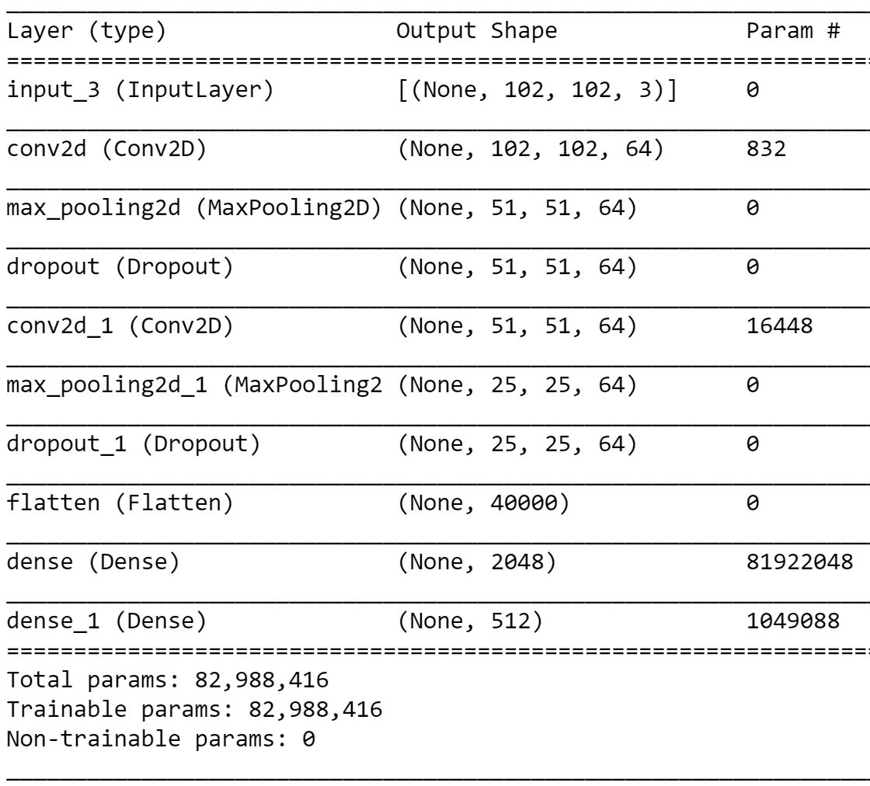
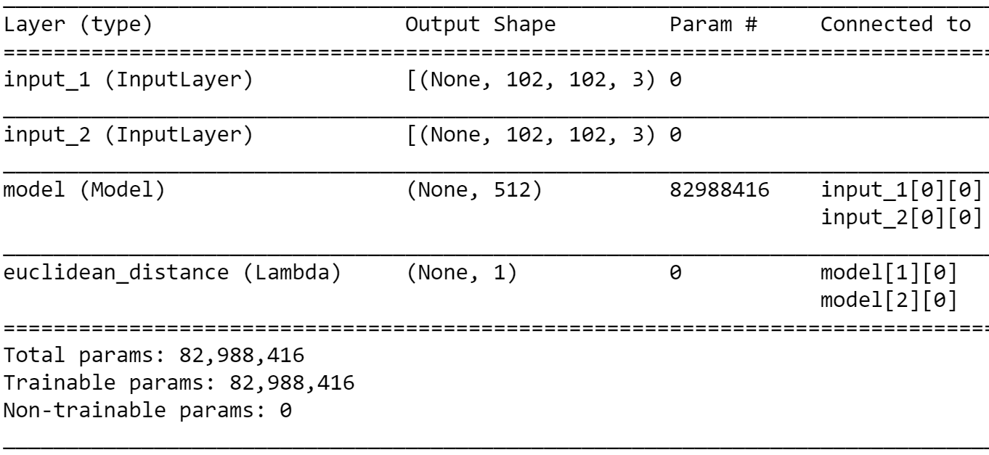
Implementation
Fig.: CNN architecture (feature extraction)
Fig: Siamese network architecture

Slide 33
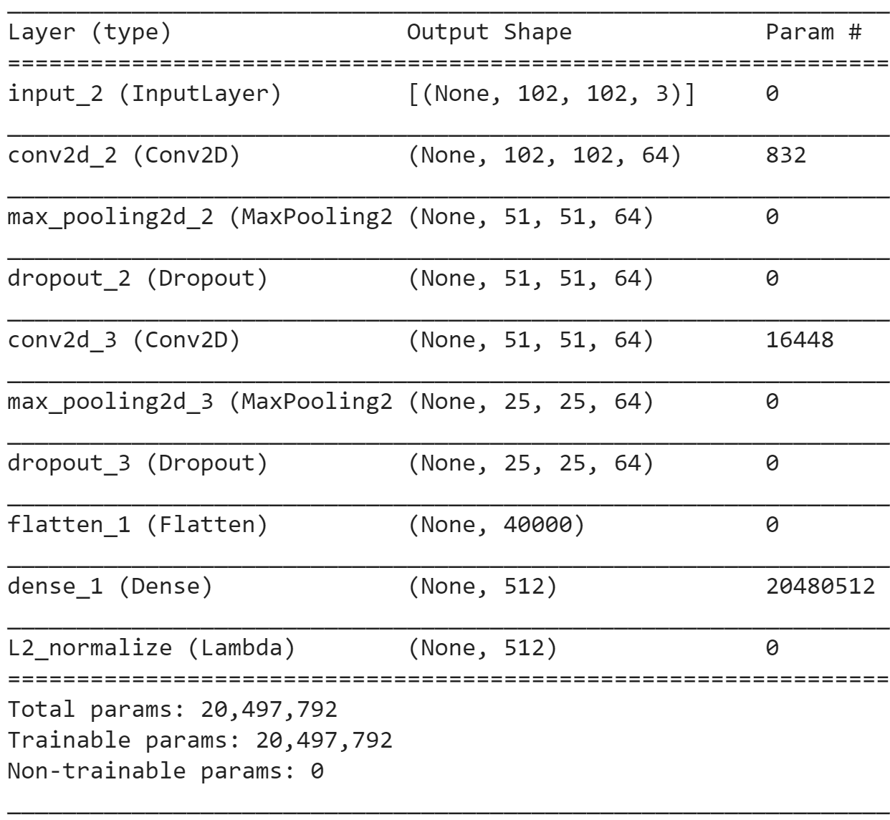
Implementation
Fig: Our Siamese architecture for triplet loss

Slide 34
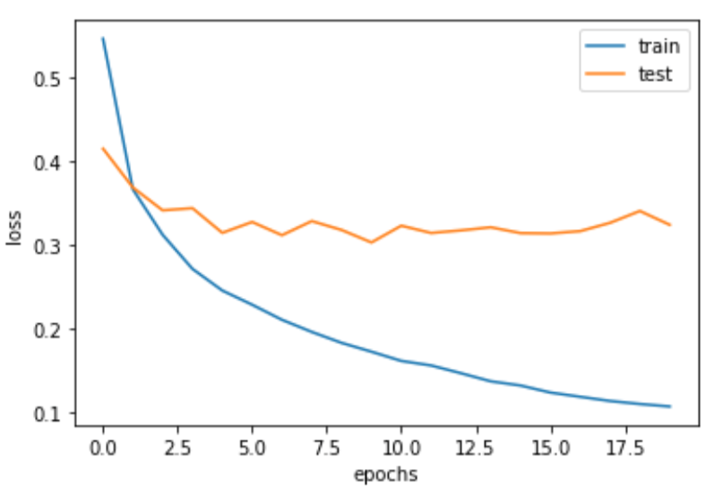
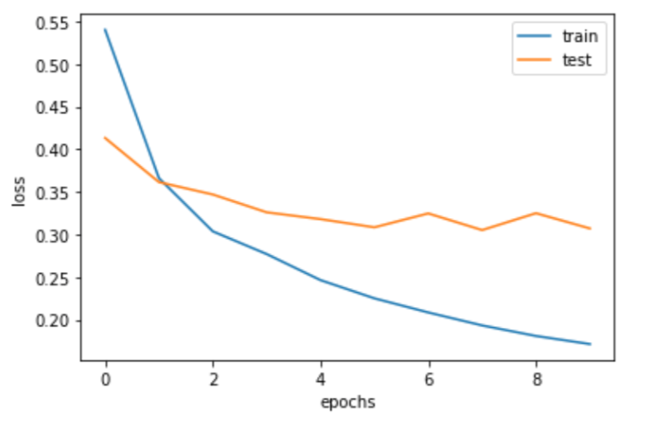
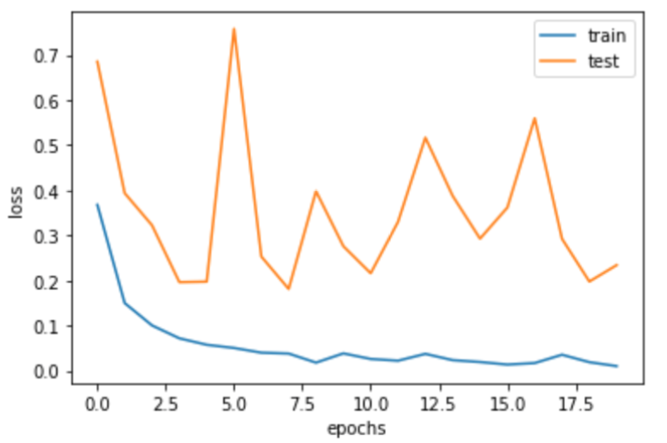
Transfer Learning
(a) Xception
(b) Xception + dense
(c) Xception All
Figure X: loss diagram for transfer learning

Slide 35
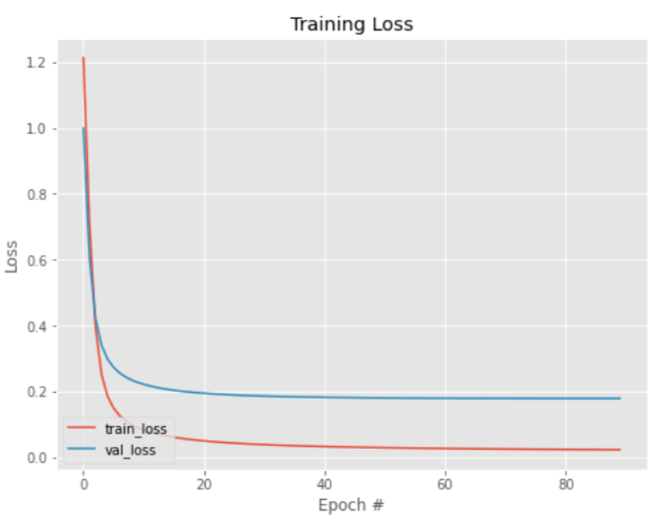
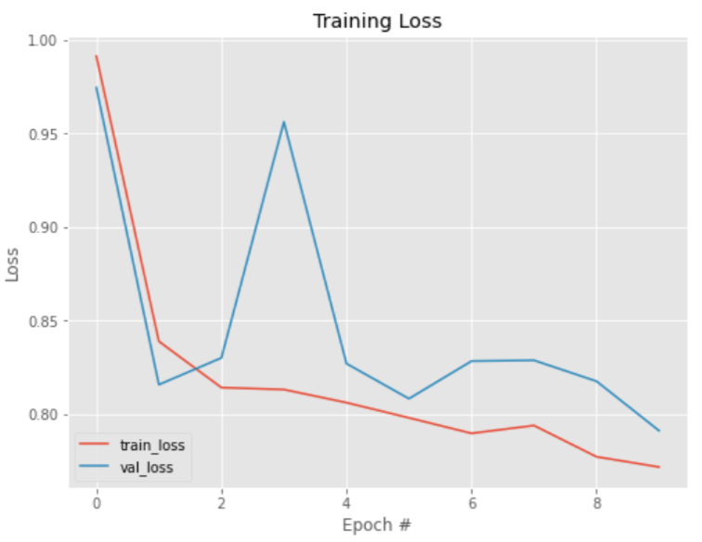
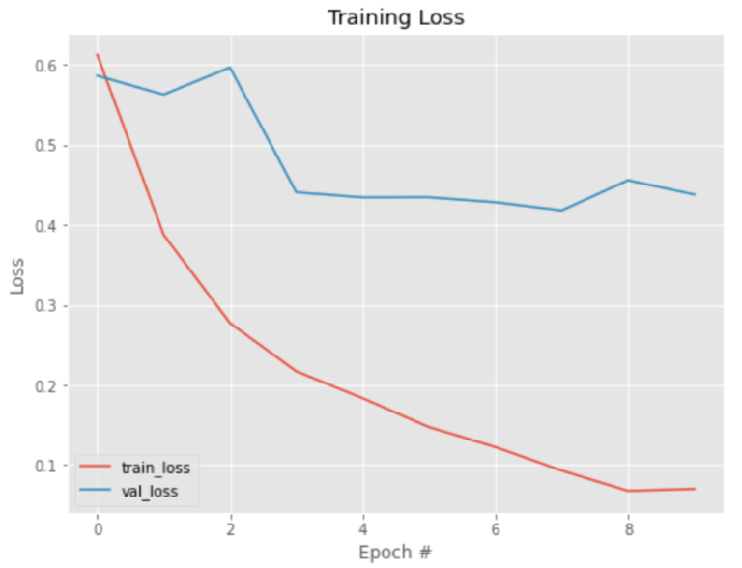
Contrastive Loss
Our Siamese + Con. loss
Our Siamese + Triplet. loss
Xception + Siamese
Figure X: loss diagram for transfer learning

Slide 36
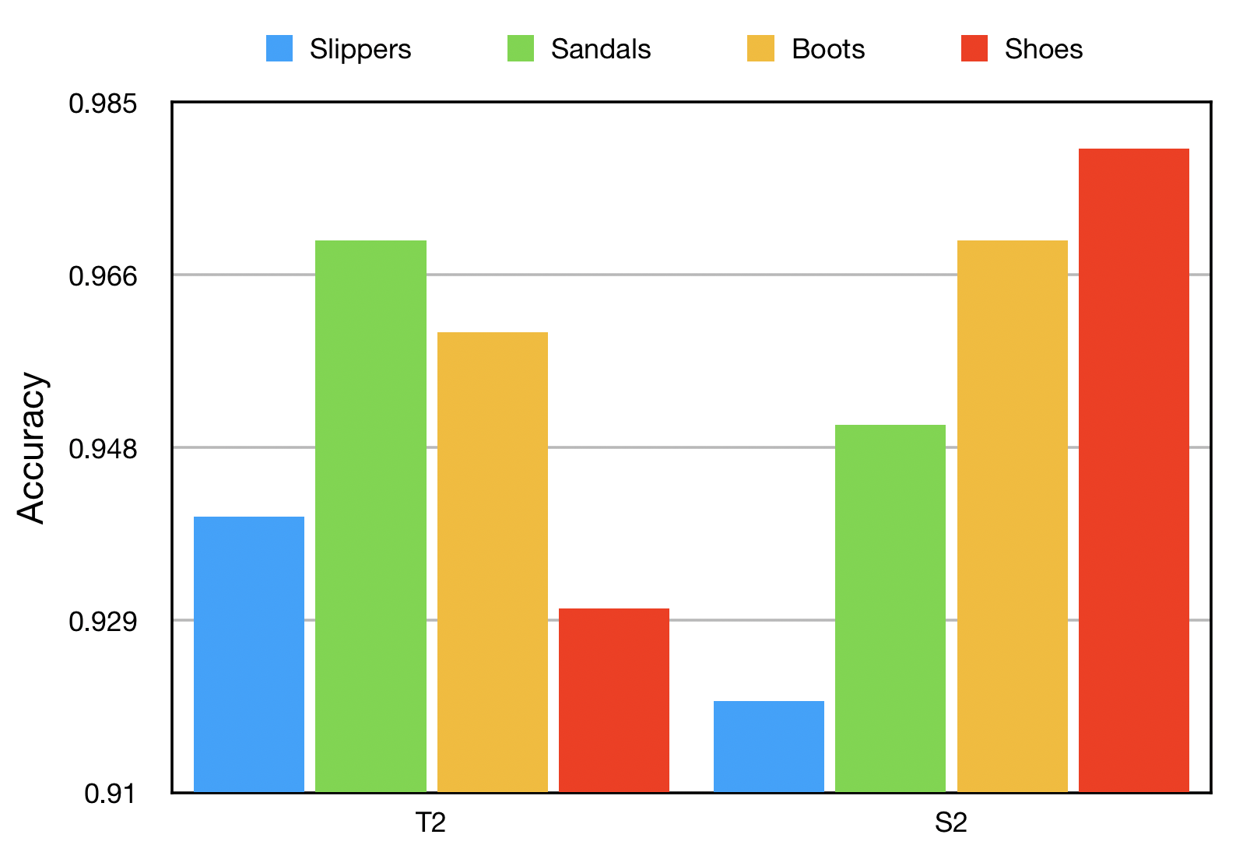
Analyze each class
Figure X: accuracy per class of best models

